Slide 1
BACKGROUND: STRATEGY

Slide 2







TOS 2020 on a page
Why do we need to shift?
What should we shift to?
How do we shift?
How do we execute?
Forces in the market driving change for U.S. Bank
Fundamental shift in the way we work
TOS leadership encouraging three overarching focus areas
Teams will be enabled with tools, training and data
Lower barriers to entry
  Customer-focused
  Accelerated
Iterate and collaborate in solution and process design, development, delivery, and operation; break down silos
We will help you
  Simple
  Integrated, seamless
Education and learning
Communication
Toolsets
Enabling platforms
Workforce strategy
Enabling organizations’ engagement
Governance and value management
Rapidly evolving customer and digital demands
  Outcome-driven
  Dynamic, responsive
Reinvent and automate processes
Automate rules-based tasks, imaging, workflow and controls, simple and complex, through straight through processing
Automate testing, deployment and delivery of technology; continuous improvement
Innovation becoming fundamental
Constantly changing volume, regulations and complexity
Increased speed, agility and scalability
Integration of business, technology, and operations teams, shifting mindset
Continuous innovation and improvement
Digitization while improving security
Using data to drive customer satisfaction and quality
Your role in this journey
1
2
3
Identify change agents
Empower your teams
Share feedback
Mounting performance pressures
Develop and augment talent for the future; continuous learning and development; People are able and equipped to pivot and change, and skilled for future growth
It is up to TOS leaders and teams to take action and leverage these enablers.
Take the lead.
Tighter integration of business, technology, and operations teams

Slide 3


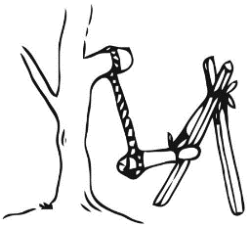
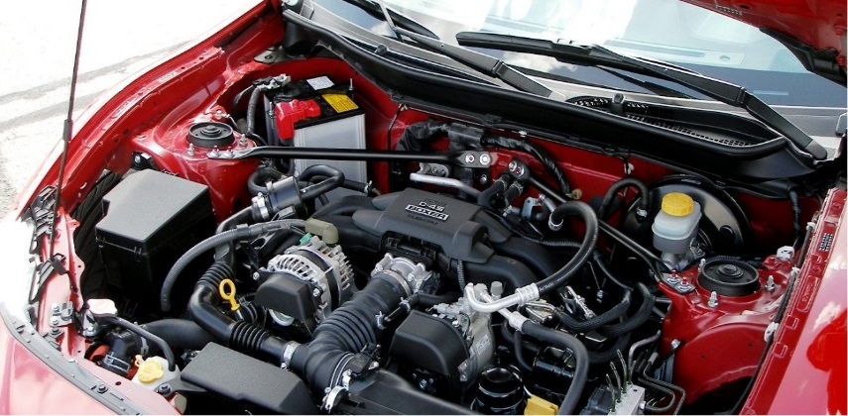
Leverage
Aligning With TOS 2020: A way forward
TOS 2020 is all about basics: Architecturally doing things the right way

Slide 4
Alignment considerations for BPM
BPM will be purely transactional business workflow engine consisting of human tasks
“Simple”, “Accelerated”, “Integrated-Seamless”, “Dynamic-Responsive”, “Customer-focused”
Increased speed, agility and scalability
  Documents upload directly to FileNet from client browsers: No overstretching of technology beyond its special purpose
    No Load on BPM servers for documents.
  Common UI/UX Theme.
  Common coach views (screen controls/sections) and common services
    Reusability: Reduce development time. Standardization
    Plug and play with controls to build apps
Integration of business, technology, and operations teams, shifting mindset
  Leverage and consolidate with Data warehouse (Foundational bricks empowers us for this): Think into reusability beyond projects
    Data warehouse will maintain and archive application Data for reporting purposes.
    BPM operates in objects, Data warehouse offers relational model.
Continuous innovation and improvement
  Simplicity: One DB design (Theme….Foundational Bricks)
    Relational to Object Persistence Model…. As BPM deals in objects.
    Dissimilar DB design of various BPM apps to one DB design for all apps.
    Core framework to build common coach views (screen controls, screen sections), common services
    Reduce design effort
  Improvement: Code for evolution.
    Organizing code in components can help to introduce better tools in future for these components.
    E.g. Having business rules in a separate component/ toolkit will enable us to migrate business rules to ODM efficiently.
Reinvent and automate processes
  BPM is all about business process automation: BPM business benefits overtime - 89 FTEs reduction, 53 million in business benefits, 17 million implementation cost.
Digitization while improving security
  eSign capabilities
  Leverage reporting tools like DAS-H reporting
Iterate and Collaborate: Agile development framework
  BPM is following Agile development framework: “SCRUM” since last couple of years.
  Automated Testing: Bringing testers to dev team to write scripts for automated testing. Steps towards DevOps.
Earn TOS 2020 Values: “Simple”, “Accelerated”, “Integrated-Seamless”, “Dynamic-Responsive”, “Customer-Focused”.
What should we shift to?
Fundamental shift in the way we work
  Customer-focused
  Accelerated
  Simple
  Integrated, seamless
  Outcome-driven
  Dynamic, responsive
Increased speed, agility and scalability
Integration of business, technology, and operations teams, shifting mindset
Continuous innovation and improvement
Digitization while improving security
Using data to drive customer satisfaction and quality

Slide 5
One DB Design: Simplicity, Consolidation
Continuous innovation and improvement.
Move away from relational model to object persistence model. As BPM deals in objects.
Move away from dissimilar DB designs for various BPM apps to one design for all apps.
Core framework to build common coach views (screen controls, screen sections), common services
Reduce design time for database. DDL scripts to create tables for applications.
Common services to save\retrieve objects as is thus offering object persistence framework.

Slide 6
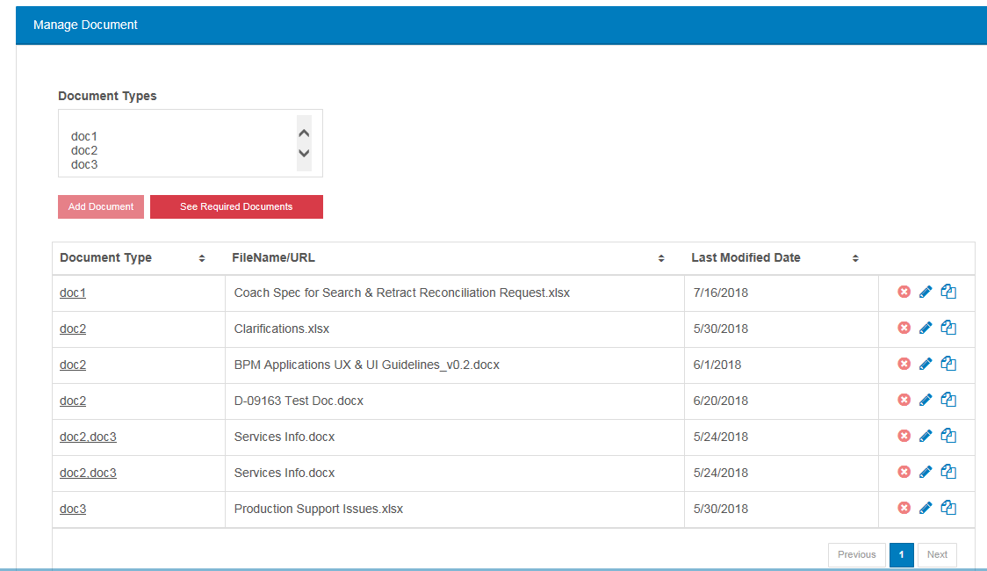
Document Upload: Manage Load Better.
Increased speed, agility and scalability
BPM is not a document management tool
FileNet is an enterprise platform for document management.
Why BPM servers have to carry the load of heavy documents traffic which will eventually house in FileNet.
In-Flight documents have caused PROD issues to BPM servers.
So.....
The control to allow upload\download of documents directly from browser to FileNet.

Slide 7
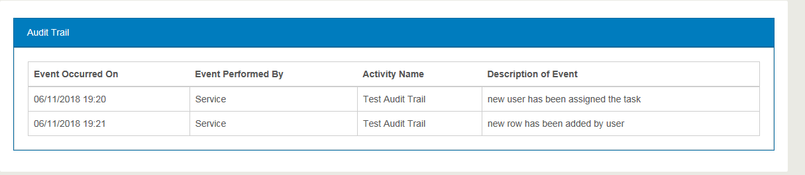
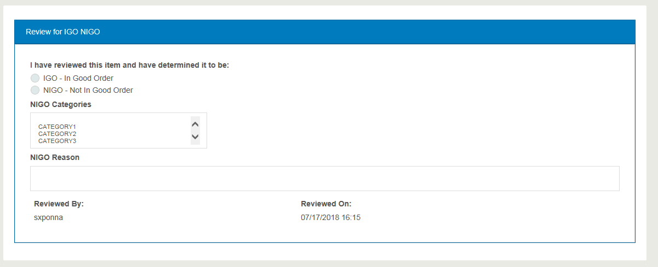
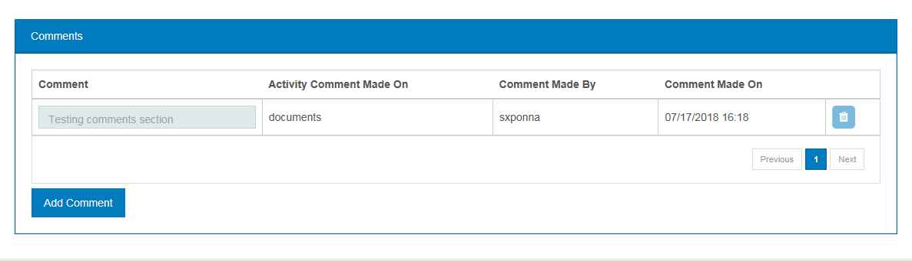
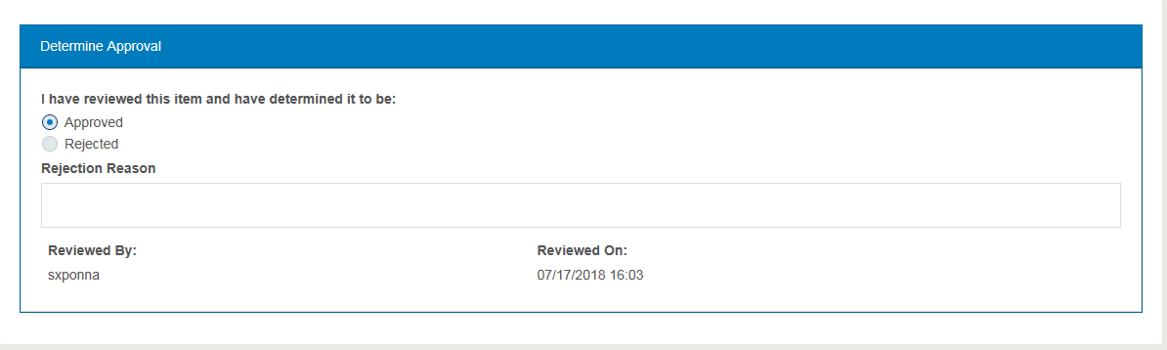
Common Coach Views/Services
Increased speed, agility and scalability
Developers & Business Analysts to collaborate on this effort.
Reduce development time. Standardization
Plug and play with controls to build apps.
  Common user controls (Coach views). Examples: Manage Documents Coach View .....
Audit Trail ->
Review for IGO/NIGO ->
Comments ->
Determine Approval ->
  Common integration services for SEI, CGS, FileNet etc.
  Common services to save/retrieve application data.
  Common services to service common controls.

Slide 8
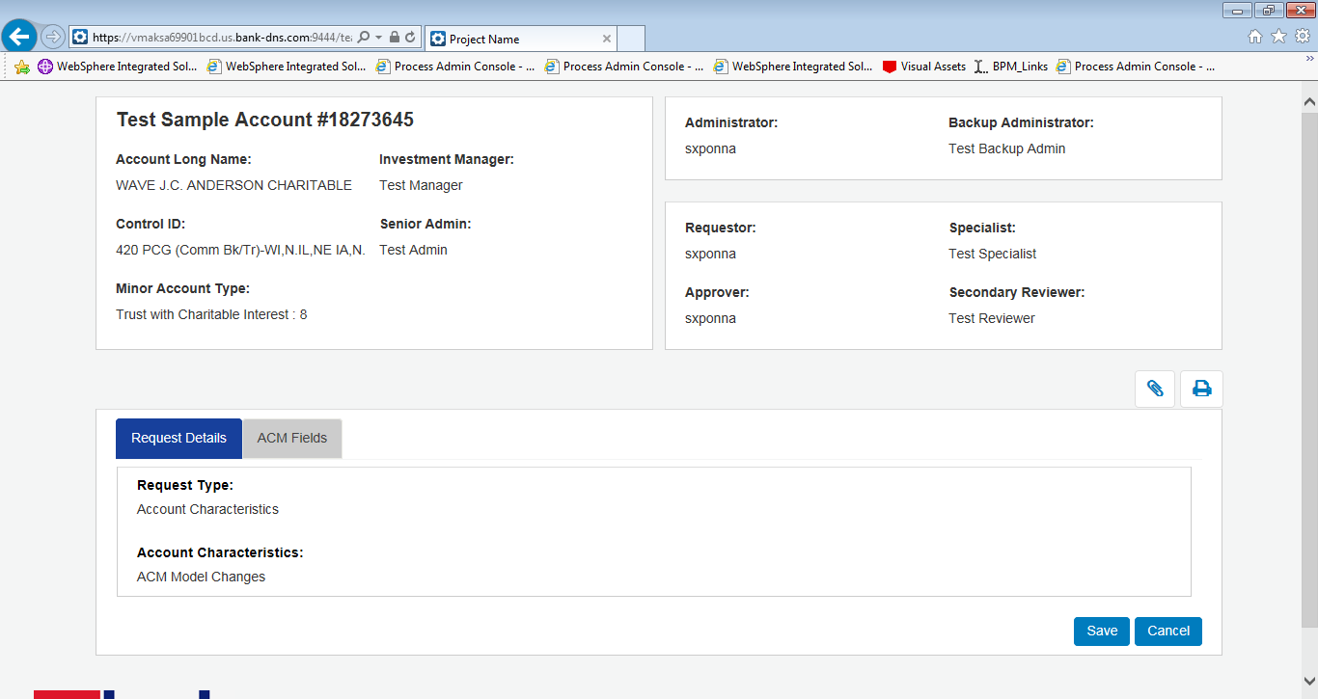
BPM UI/UX Standardization
Increased speed, agility and scalability

Slide 9







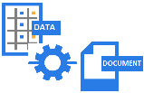


TOS 2020 Project Scope: FS ICE: Integrated Customer Experience – Context Diagram
TOS 2020 box on Context diagram can help us realize TOS 2020 values that are gained and other areas of improvements
Pre Sale Activity
Servicing team/ Sales team
Mutual Fund/Hedge Fund Client
Sales team
Clients/
External Auditors
Fund Administrators
Operational Staff
Internal Auditors/ Data Stewards
Relationship Manager
Client
Fund Administrator/ Operational Staff
Initiates OnBoarding Process
Paperless Experience
Prospects/
Opportunities
Consume
EAGLE
Reporting
Analytics
Web Presentation
STAR and PACE
GFSO - BPM
IS Data Platform
AIS Cust. Portal
More....
System of Reference
Middle Tier
OnBoarding Process Workflow
Data Warehouse
AEW
Data
Integration
Operational Data Store
Data
Ingestion
Nasdaq T1
Data Hub
Pending Trades
More....
CGS
FileNet
Data Integration
Reporting Service
Systems Of Record
Trial Balance
Callouts/ TOS 2020 values
Data consolidation with IS Data Platform.
Cloud Adoption with enhanced Tech stack on Data platform.
OnBoarding Roadmap completion: Only GFS was missing.
Automation: GFS OnBoarding process.
Drive Customer Satisfaction: Fluid Client Experience, Paperless experience.
Digitization while improving security: eSign capabilities.
Seamless Integration: Process Workflow (BPM) TO Data Lake (IS Data Platform).
Ledger Activity
Advent Geneva(US)
Advent Geneva(EU)
More....
Eagle Platform Upgrade
Reduce Operational Risks.
Enhanced Integration Capabilities.
Enhance I/O operations with new infrastructure.
Other GFS Systems

Slide 10
BPM to Data Warehouse: Integrated Seamless
Integration of business, technology, and operations teams, shifting mindset
BPM is a transactional system. So let BPM do workflows and manage data for active workflows
BPM deals in objects so BPM should save/retrieve data in Objects, more specifically object XMLs.
Data Warehouse should be able to read the XML and save into relational tables.
Data Warehouse has the tool to auto-create tables using XSD (XML structure definition) and then map XML to tables using ETL.
Data Warehouse will have the relational data and it manages archival /reporting and can act as Data Lake.
Benefits
The tools are being leveraged where they are best at and are filling in the roles for TOS 2020.
The integration between BPM and Data warehouse will be reusable\repeatable across projects.
Will Realize seamless integration between workflow system and data system.
This will reduce effort for BPM team significantly where they don’t have to create relational tables and queries for reports.
Quite a few production issues we had in BPM PROD environment were due to long running queries on these relational tables, which can be prevented altogether.
This will even help while gathering reporting requirements and reduce analysis cost as all data is already there.
Facing Roadblocks in this strategy! Why?
Not everybody is aligned with same vision. BPM team is aligned with this strategy but Data warehouse may be not.
Every team has its own priorities and project work to take care of.
You can remind other team of TOS 2020 and discuss with them about their possible roles in it. But they may not necessarily agree with you.
Unaligned teams is a big hindrance to realize high level strategies
Grouping teams together, lead together can align them to produce one priority list for big initiatives.

Slide 11
TECHNOLOGY PRINCIPLES
1. Unified customer experience. For each of the four “humans”, we will deliver unified experience across all our businesses/products (rather than product-specific experiences), with the objective of maximizing customer engagement
2. APIs: Our technology stack will be delivered and accessed via APIs, micro-services, for both internal and external uses. All APIs will be documented, published, and discoverable, and will comply with our API standards
3. Open-banking APIs: As far as possible, our channels will use the same APIs as the “open banking” APIs which our external partners use
4. Re-use. We will leverage shared, reusable services and APIs for the most common set of services including: authentication, on-boarding, money movement and interaction management. These shared services apply across all our products, and will be continuously modernized and functionally enhanced with feedback from adopting teams. All customer experiences will need to leverage these shared services
5. Unified data layer & infrastructure: All data access (read, write)for operational and analytics uses via unified data APIs. These APIs provide real-time, low latency access with built-in security and access controls for delivering timely information at all touchpoints; will enable predictive insights and productionized models for personalization; and self-serve analytics.
6. Cloud-first. All new applications to be deployed on AWS or Google Cloud.
7. Open source. Leverage open source tools and software wherever possible
8. Hollow out the core. The core systems (e.g Hogan) should only be used to fulfill their primary purpose as systems of record. Data and processing not relevant to that primary purpose will be moved out of the core, and applications will use services or data APIs, rather than directly accessing Hogan or other core systems
9. Software Resiliency: Each application, service and API will be designed & tested to be atomically resilient and scalable.
10. Architectural rigor: Any exceptions to above principles need to be explicitly approved by Enterprise Architecture (#2,6,7,8,9), Shared Services Architecture (#3, 4), and Data Architecture (#5). Unified customer experience (#1) will be ensured by CDO.

Slide 12
Background: OneBridge And Doers Village

Slide 13
TOS 2020 Bridge: A bottom up approach
Making 2020 easy and exciting for organization: Change in culture
TOS 2020 bridge website inviting process improvement ideas, challenges, problems even questions on TOS 2020 to be submitted from throughout the organization.
Quarterly challenges to collect improvement ideas, issues to get top management buy-in. TOS 2020 matrix, teams grading.
Customized emails to groups. Make TOS 2020 easy, inciting feedback.
  Am example.
    Hi BPM Team
    With TOS 2020 initiative preaching us some values and targets, the main focus of this email is that how easy is TOS 2020 for you. We need to make TOS 2020 as simple as possible to bring change in culture. We have resources available for you to take a look:
    TOS 2020 Portal
    However other than that let us give some examples, which are custom to your group, to make TOS 2020 exciting for you and make it habitual. Do you feel that projects you are working on have room of improvements in following:
      Make common code artifacts, so that they are reusable in future projects. That could reduce development cost significantly. Is that happening enough? If not then why you think it is not happening enough?
      The integrations between BPM and other technologies, are they reusable across projects. Is there any room of improvement here?
    You can add all your suggestions, even your questions on TOS 2020 here:
    TOS 2020 Bridge
    These simple inputs will go long way and will make you significant change agent for TOS 2020. Let’s grow together.
    Highly Appreciated
    TOS 2020 Team

Slide 14
One Bridge Value Additions
Doers Village
  Setting up a path for idea to fruition.
  One Nod
  Powerful combo: business experts and technology experts.
  Doers Village
    TOS teams
    BL partners.
    Strategy teams.
  OneBridge COE
  No Fund, no problem!!! (At least hope so)
  Defragmenting work hours and consuming them to build ideas.

Slide 15
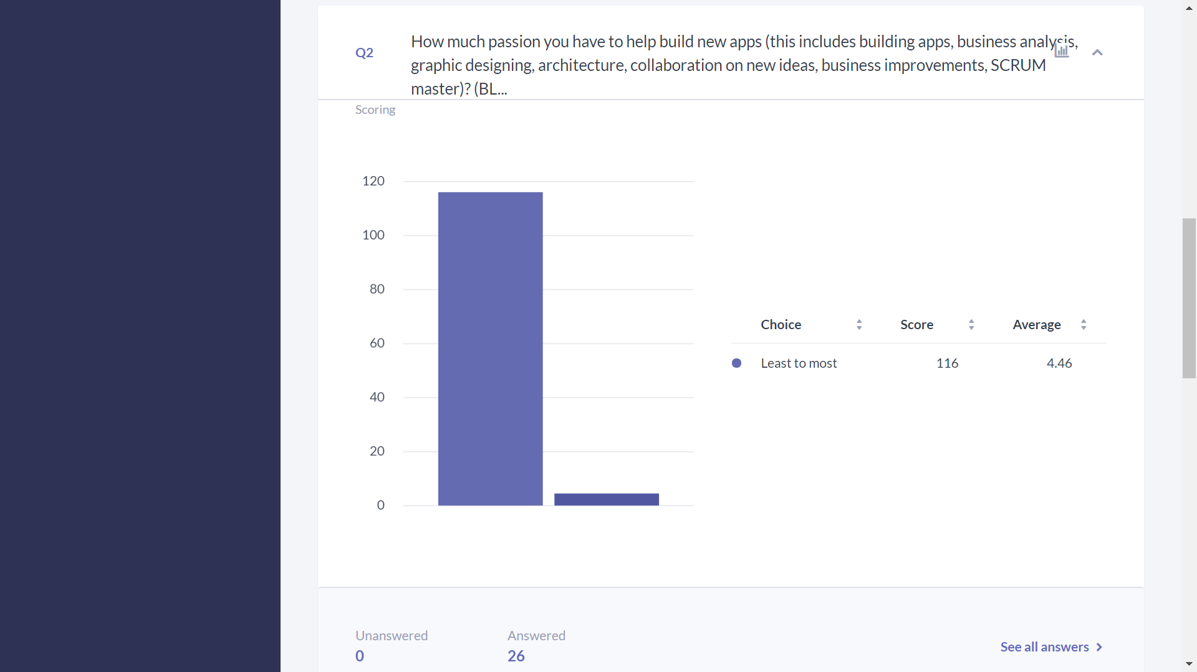
* This question has a range from 1 to 5

Slide 16
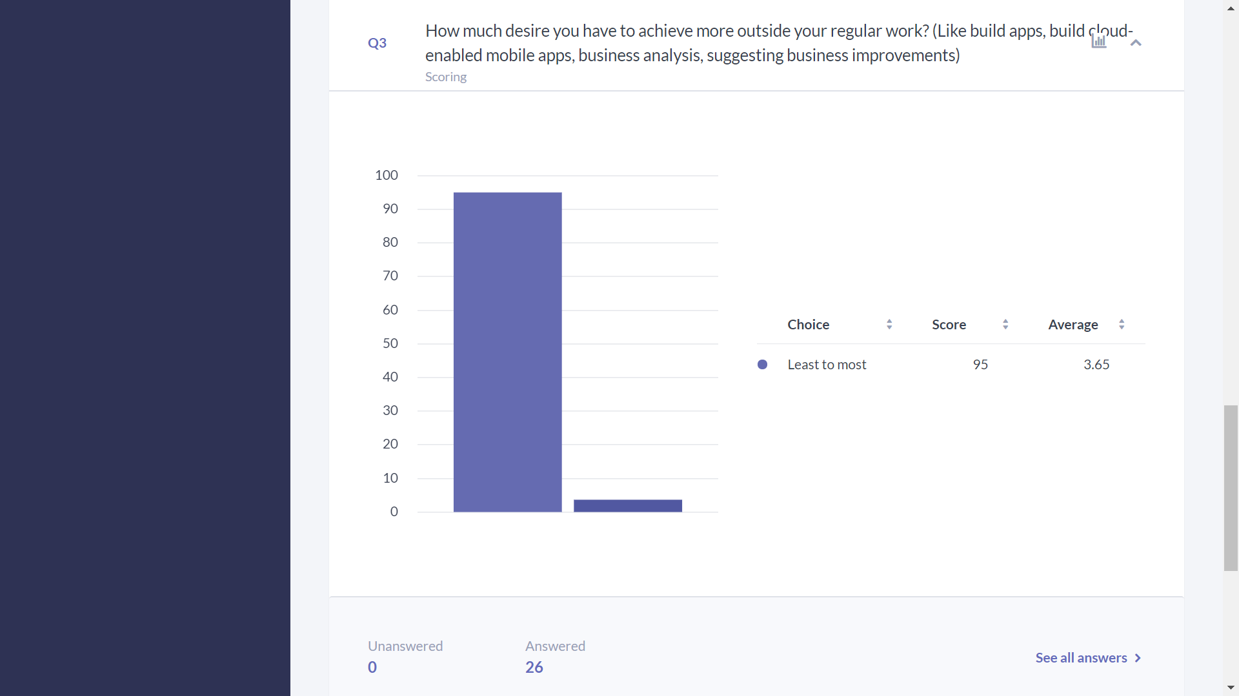
* This question has a range from 1 to 5

Slide 17
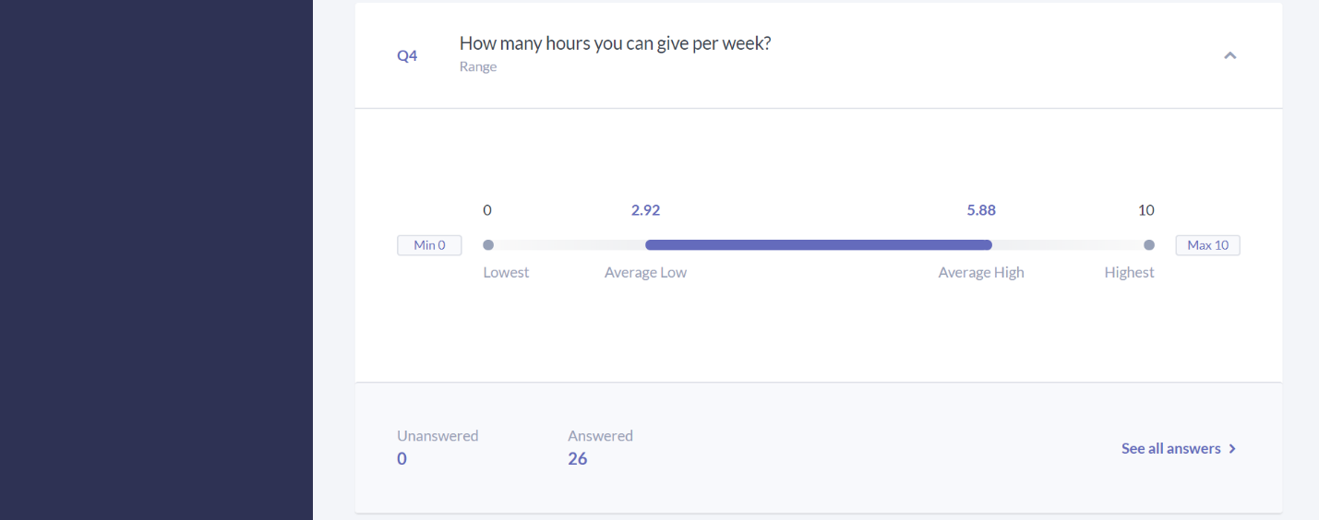
* This question has a range from 0 to 10

Slide 18
INNOVATION FORUM

Slide 19
Why we need this?
Problems
Things happen incoherently.
Things are not completing.
Duplicate efforts
Business Line Strategy and TOS strategy are not all the same.
Funding issues.
There are roles/ champions assigned to work items/strategies from top but connection with the team doing work is missing or vague.
TOS groups may have heterogenous (not aligned) strategies
  TOS groups have different priorities or timelines.
  One strategy implementation across multiple TOS groups cannot be accommodated through Capex model all the way through
Business lines face issues in features additions.
  BLs can’t get even get small features implemented (automating a spreadsheet) unless it gets into CAPEX.

Slide 20
Innovation Forum: Automation COE
Moving to next level
What can be Done?
Consolidate In-Progress Work: What is already happening? Bring it to forum so that more can contribute to possibly achieve more and better.
Applying Technology principles: Using technology principles come up with improvement ideas and pick lead from the group, depending on the interest.
  Increase visibility and implement Enterprise Initiatives simultaneously: Link up with corresponding enterprise group and join their weekly/bi-weekly meetings to learn and implement or introduce them our efforts in same domain. EASE team, CDaaS, CAWG, CDO
  Finishing touches: Apply finishing touches to add services to enterprise repository. Like adding Wise/ Ease proxy to core services. Consider example of FileNet upload service.
  Services could be w/wo micro front ends: Service can be micro front ends, returning html that could be hooked up to other web apps.
  Alignment with WM/IS Architecture Group
Ideas from within group:
  Increase Reusability – Reusability Architecture: Building common/reusable onboarding components. Masood has recommended some ideas regarding this.
  Enabling new tools – Road towards Enterprise Engine: IBM Automation tools like IBM Case Manager. DevOps tools. Cloud services that can be leveraged.
  Admin tools: Monitoring, Scalability measures. Support utilities.
  BPM to Digital Automation.
Shape:
  Picture the next level: Stage by stage snap-shots.
  Membership: Select one to two persons from your group.
  Specialized Resources: Specialized resources, like technology lead, support personal, tester, BA should be part of this forum.
  Bi-weekly meetings.
  Meeting with Delivery Managers to prioritize work.
  Web Repository/List (Possible Automation) : All efforts/ services should be added to this web repository and who is leading the effort.
  Get trained and train others: Teach the effort you are leading to other parties and learn yourself and train others.
  Meeting with Architecture Groups (David Nee, Damodar)
How to Make it Matter: Need Manager’s support. Any suggestions here…
  Teaming up and Collaboration: Also somebody leading an effort may need couple of resources offshore/ onshore to work alongside him.
  Meeting with Business Leader/TOS Leader/ Tech planning meetings: To evaluate ideas.
  Who is leading what List: Leading as Architect or leading as App lead or App Manager.
  Growth opportunity: Leading as Architect or managing other people.

Slide 22
Work Initiatives
What’s possible?
Topic | Emerging | Mature / Supported | Deprecated / Legacy / One off | Obsolete / End of Life
Items in this category | New future directions and areas in pilot. Use at your own risk. Long term support not defined. Items in this category could end up one off POC’s that are abandoned. | Currently accepted and proposed solutions for new development. | Okay for existing development but not positioned for new apps. | Not supported for new applications. Apps must plan to migrate from these asap.
BPM User Interface | React dynamic field UI: POC underway and may be ready for use in early 2021. Build as reusable controls. IBM BPM UI: React interaction with coaches (mixed headless) | IBM BPM UI: Adopted new shield UI. Standard for normal bpm processes going forward. Coach views. * New cap ex projects should check with architecture on status of react and headless coaches | Brazos: In use by large number of bpm apps. Compatible with web designer but comes with licensing costs. Angular headless BPM: Used by FSAO. Future direction is React for headless design. | IBM BPM 7.5 UI: older style coaches are not compatible with web designer, EOL in 2021.
Process Flow Diagramming |  | Blueworks Live Visio
API |  | Apigee REST API | SOAP API | Oracle Service Bus (OSB)
Data Management | ELZ 2.0 / Kafka

Slide 23
Innovation Forum: Lead Role
Lead to what’s next
Automation Champion:
Lead an Automation initiative (APIs, Digital, technology/capability, a project modernization, cloud)
Will spend 3 to 5 hours a week.
Can make team of champions to add specific roles: BAs, UI/UX expert.
Works with project team to make sure if Initiative work is on track
  Any resource requirement (Can be fulfilled through offshore)
  Initiative Issues list
Update/ Share status tracker.
Meet with related Enterprise Teams, TOS leadership
  So that he has knowledge of the Enterprise Strategy
  If we are aligned with TOS strategy Or if there are any gaps and why?
  Share if business has a different take in relation to a TOS strategy.
  Understand and communicate funding issues.
Meet with Business Line/ Project Lead
  Help convince business line to bridge gaps between business strategy and TOS strategy where needed
  Understand their business model and funding model
  Evaluate an economical/optimal path.
Manage scope (can increase scope or propose one step a time) of the initiative he is leading.
Communicate with Automation Forum (Knowledge, Status, Resource requirements).
Help further describe and provide insight to outside our Automation group.
Attend to Related Forums and Notifications and update team.

Slide 24
Automation Champion
Who List
Our end goal is to identify champions for initiatives who take charge and make things happen. If some work is already happening, it can be tied to Innovation forum to scope it out properly and to have one view to all.
Innovation Champion | Team of Champions | Initiative | Scope | Business Lines | Application Leads | Enterprise teams | TOS Leadership

